Slide 1

Automated Drosophila Sorting System
Integrated Systems Design II: Project Review
Spring 2026
Dylan Britch, Ainara Garcia, Rivers Henderson, Camren Khoury, William McGlone, Megan Mcnuer, Avi Patel
Holcombe Department of Electrical and Computer Engineering
Clemson University
Notes:
Ainara
The technical video should be 8-12 minutes in length. It should cover motivation, problem definition, description and discussion of your design solution, performance analysis, project strengths and weaknesses, and demonstration of the project. The audience is often most interested in seeing the project working. It is often helpful to distribute demo clips throughout the video rather than just at the end to draw the viewers in. While discussing the motivation, you may also want to also target technically inclined (but not necessarily technically trained) audience, for example, prospective engineering students (e.g. currently in high school or first year of colle

Slide 2
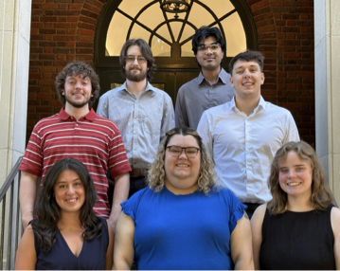
Who we are: Team 8
(From Top to Bottom, Left to Right)
Dylan Britch
Avi Patel
William McGlone
Camren Khoury
Ainara Garcia
Megan Mcnuer
Rivers Henderson

Slide 3
Objective/Motivation
Hold Flies
Design and 3D print parts
Wiring and Motor Control
Sort Flies (M/F) , rate, by doing it with the camera, success rate
Computer Vision for identifying, sorting, and counting flies
Perform assay
Stay under budget
Given a vial of flies, a user could dump the vial into a channel and walk away. From then the execution was entirely robotic and hands free. Our motivating factor was to find a better use of the user’s time elsewhere while their simple and automated tasks were completed in the background.
Notes:
Ainara

Slide 4
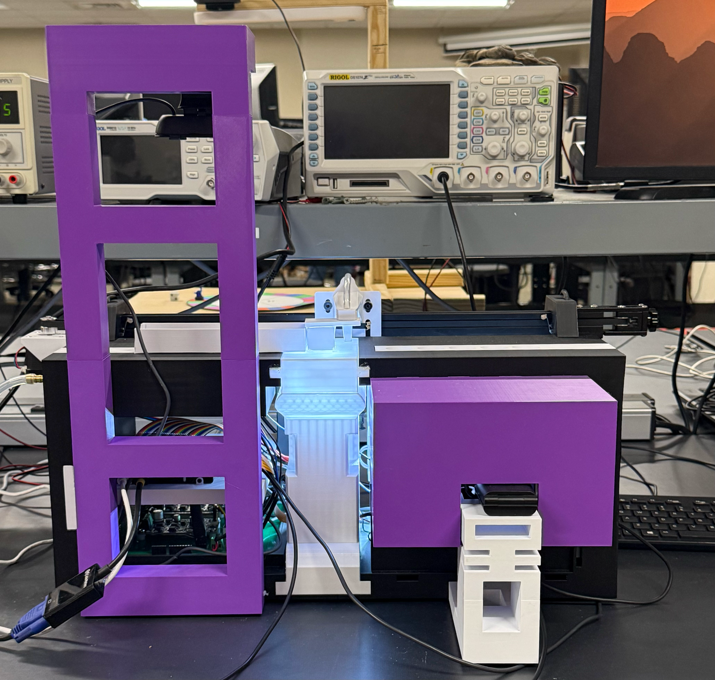
Project Goals and Deliverables
All mechanical designs complete and function (movements complete start to finish done in 15 seconds)
Database trained, complete and working (with ~80-99% accuracy as the goal)
4 flies sexed and sorted per minute
GUI with start/stop sequence, report generation and minor debugging
Assay complete with report generation through GUI
Instruction booklet complete and integrated clearly
Notes:
Ainara

Slide 5
Workflow
Channel
Sorting Camera
Assay
Gantry Movement
Gantry Movement
Notes:
Rivers

Slide 6
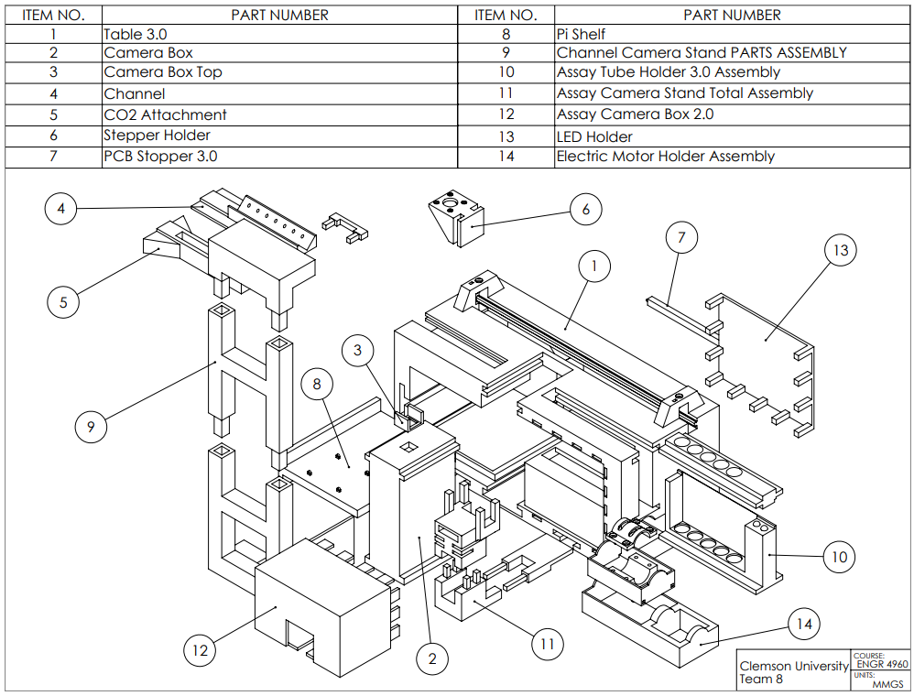
Hardware Design: 3D Prints
Notes:
Rivers

Slide 7
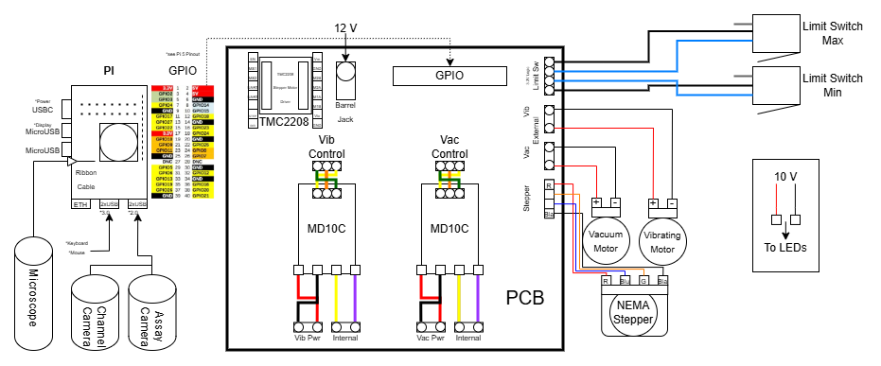
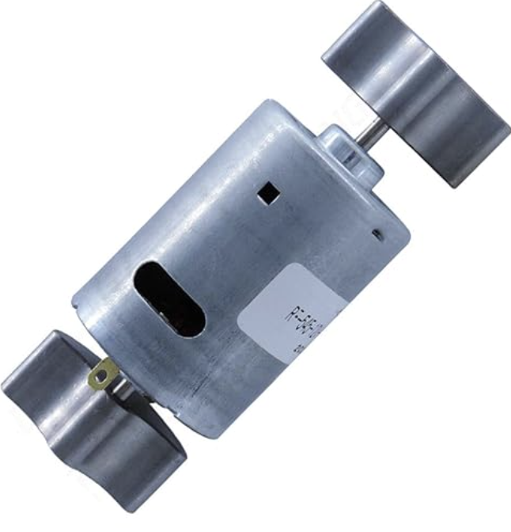
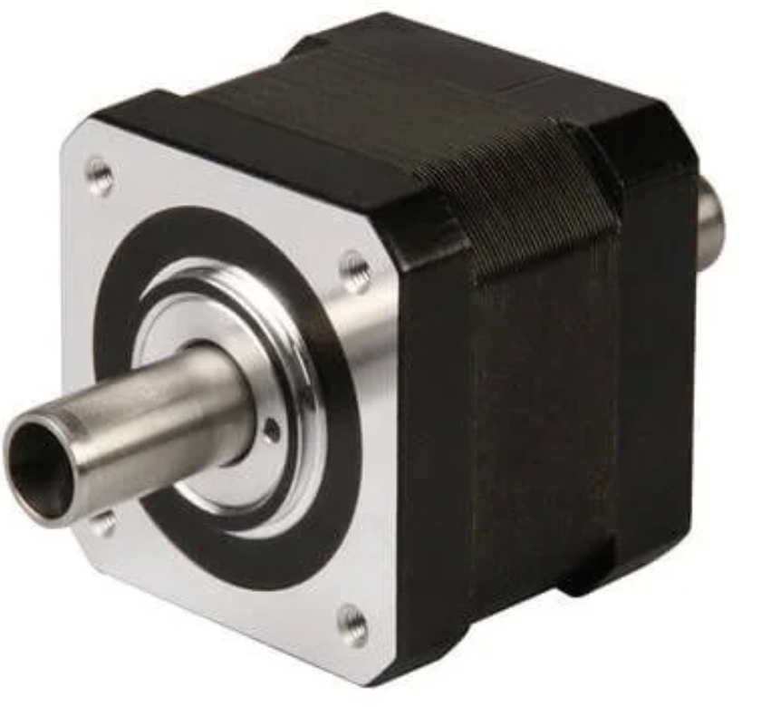
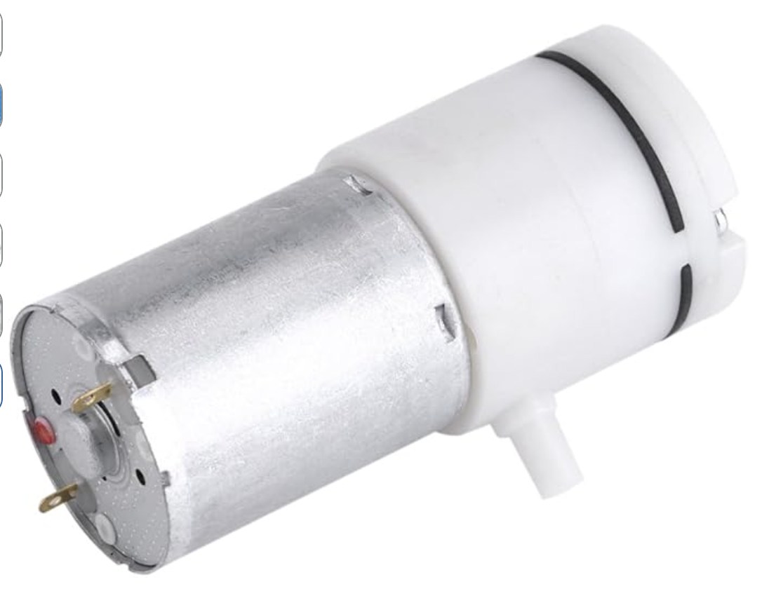
Hardware Design: Wiring
3 Motors:
Nema 17 Stepper Motor
12VDC Eccentric Motor
12VDC Vacuum Pump
Notes:
Megan

Slide 8
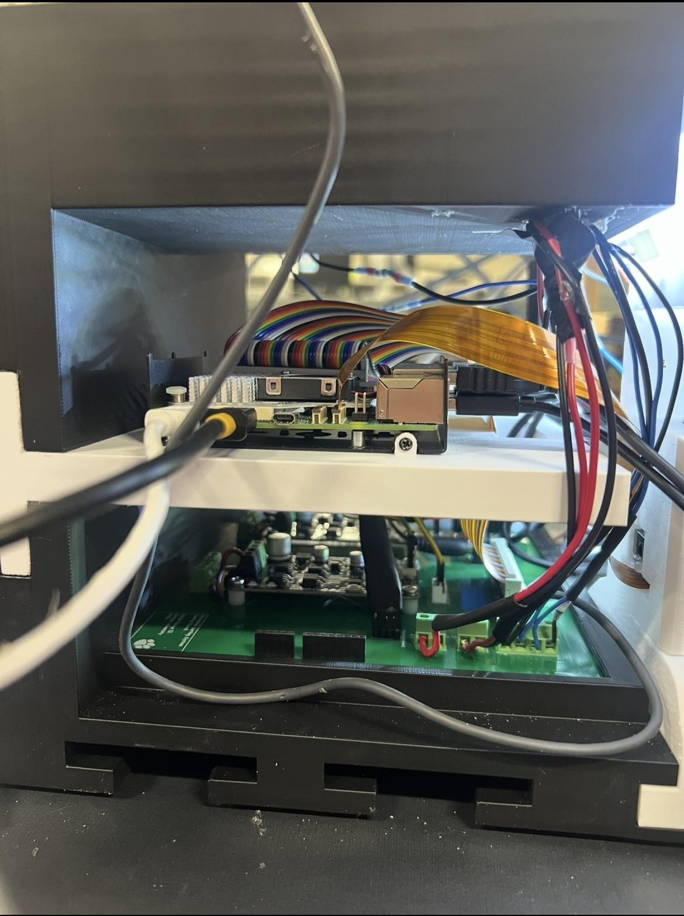
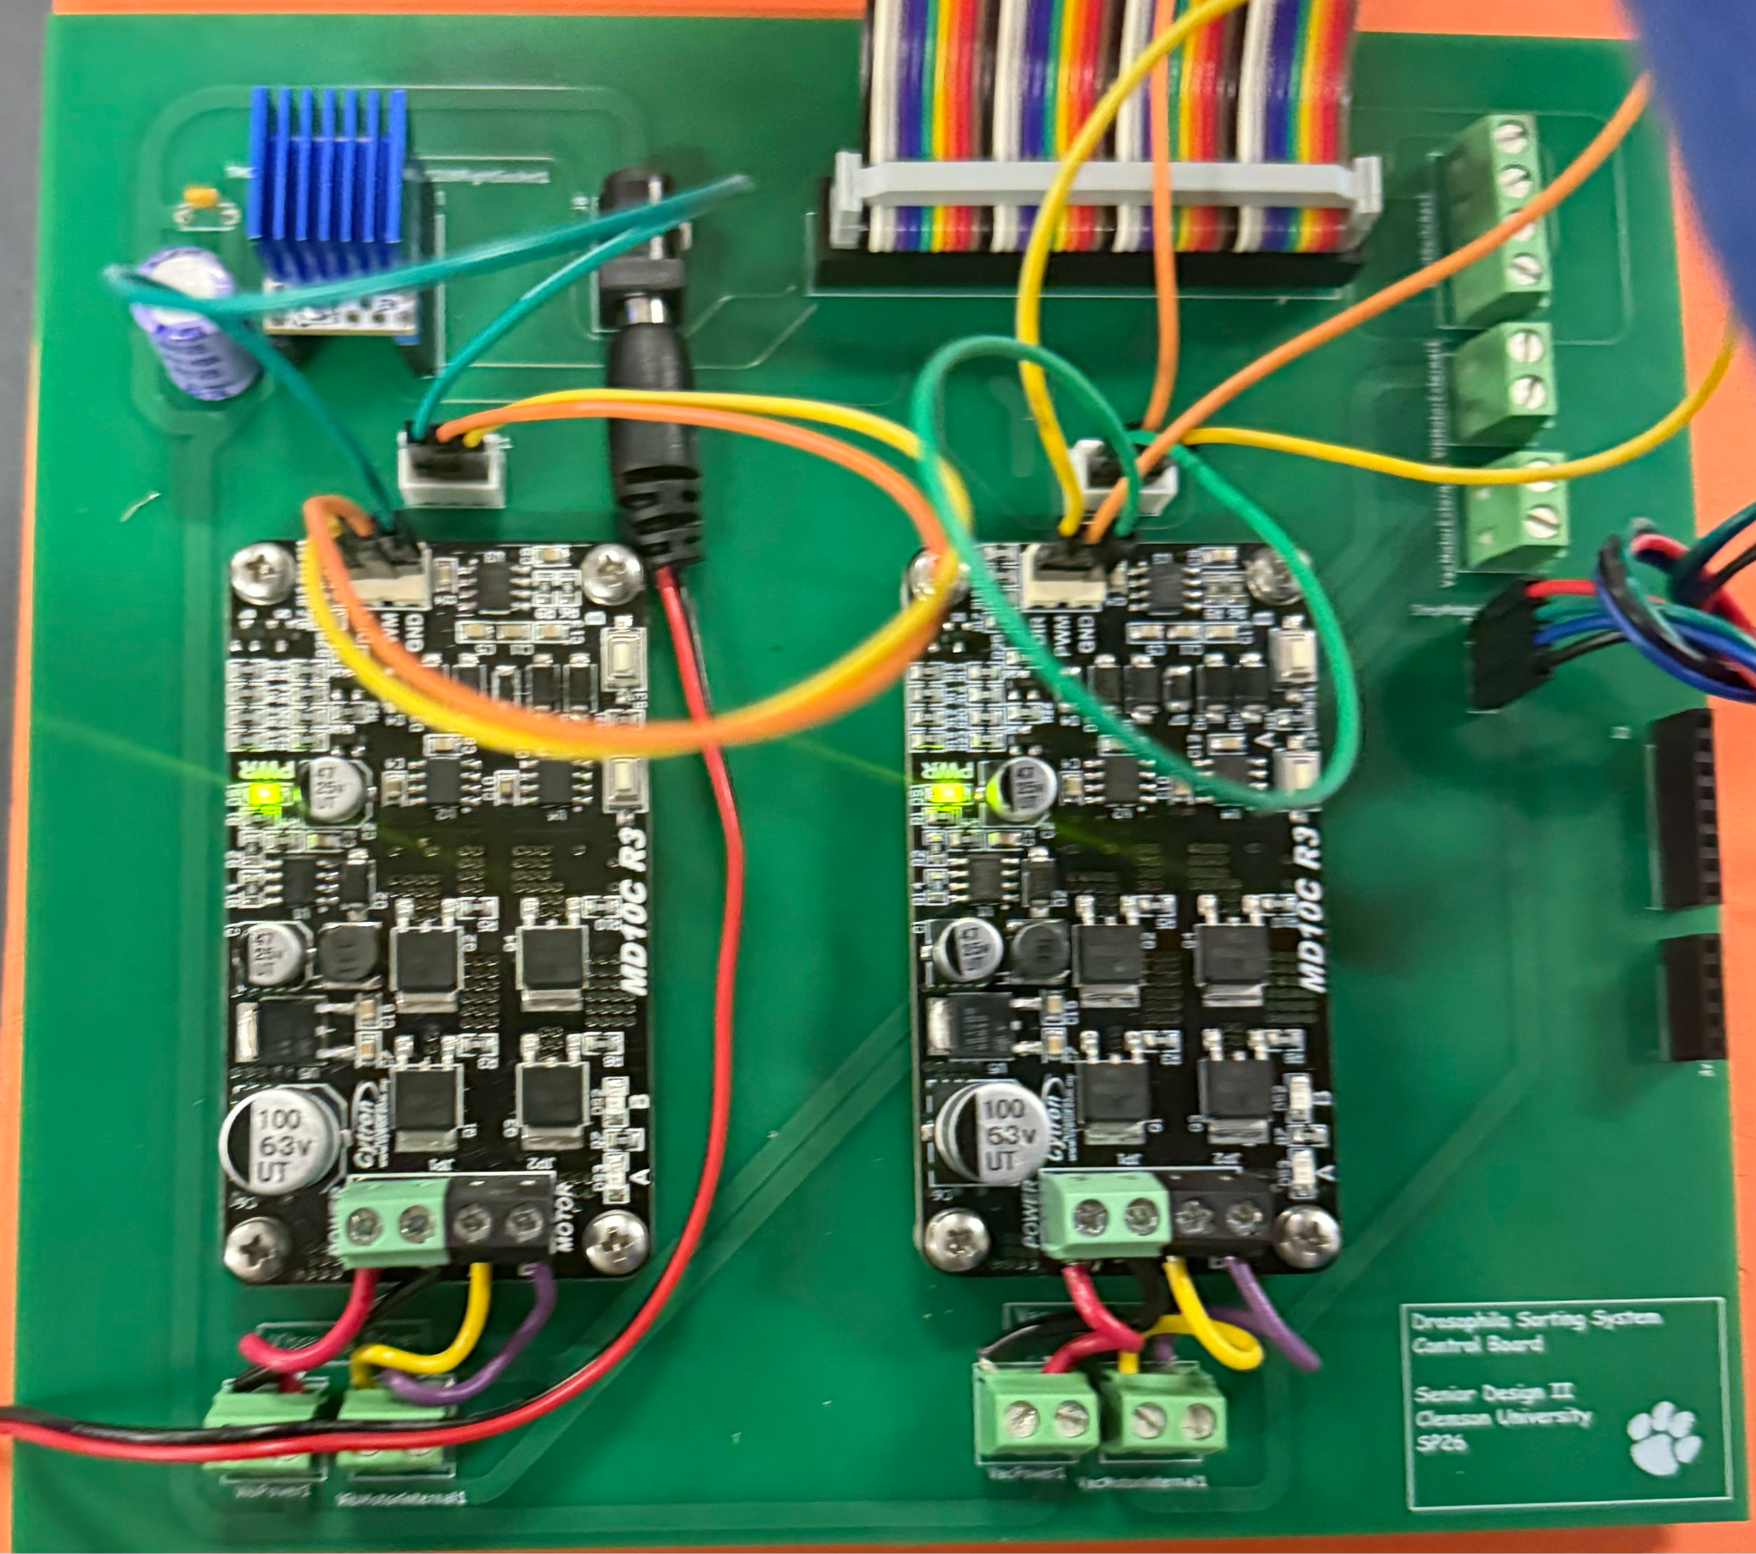
Hardware Design: Wiring
PCB designed in KiCAD to simplify wiring
Contains the stepper motor driver, DC motor drivers, barrel jack 12V connection, and GPIO pins
Notes:
Will

Slide 9
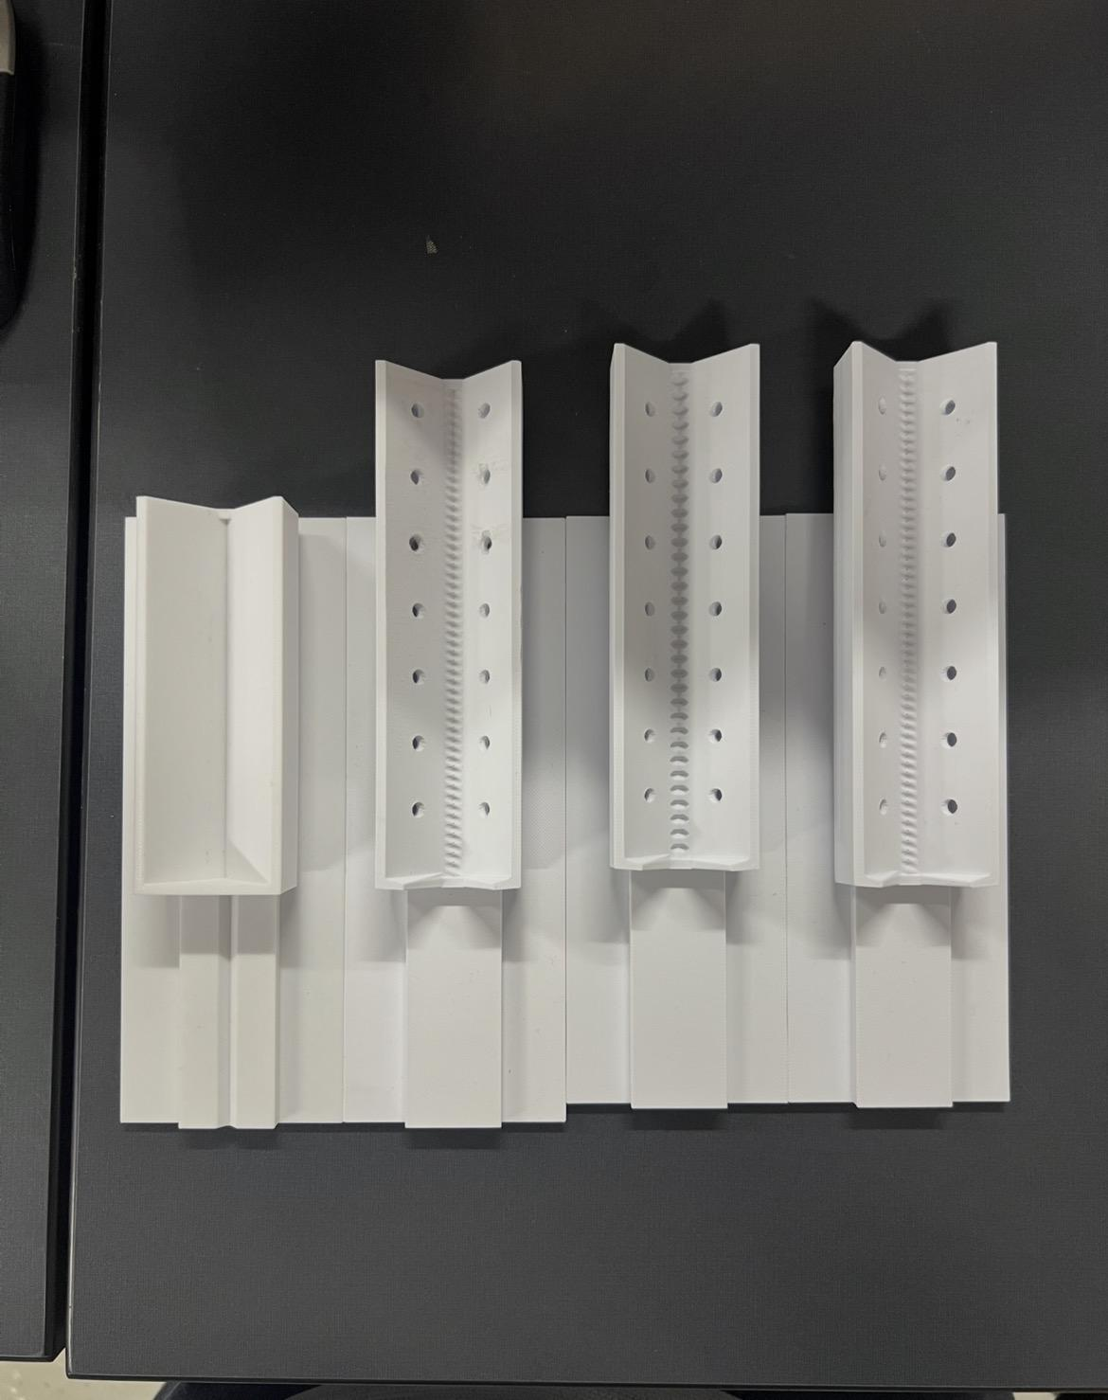
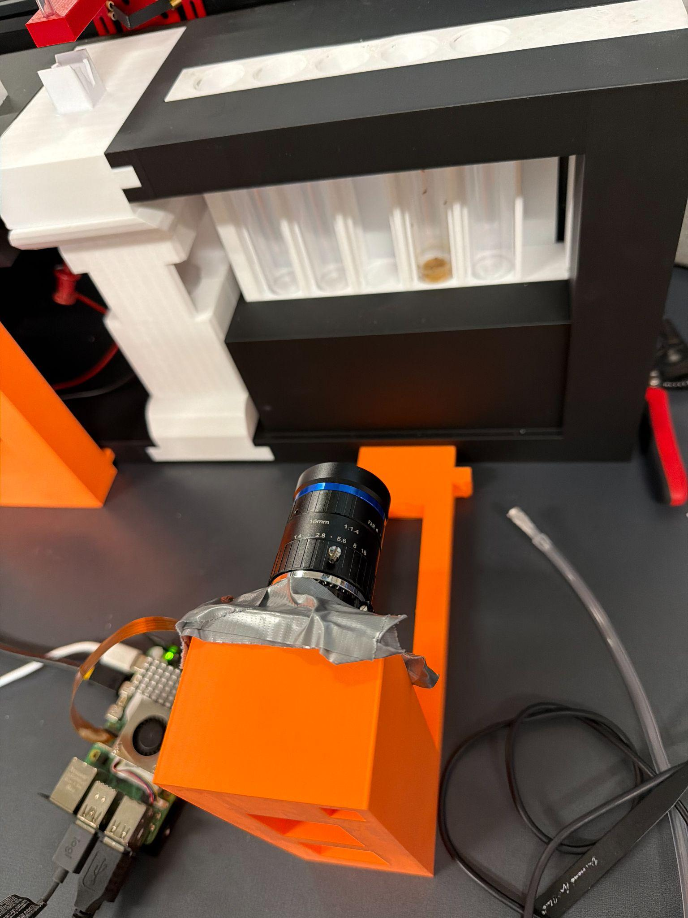
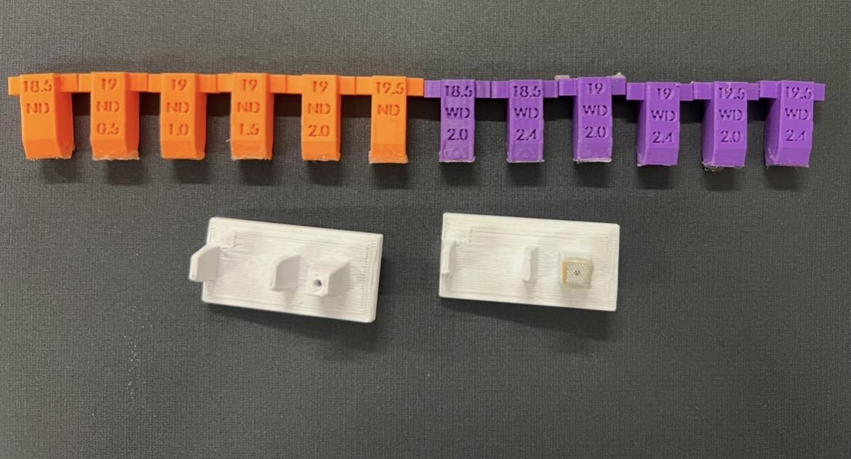
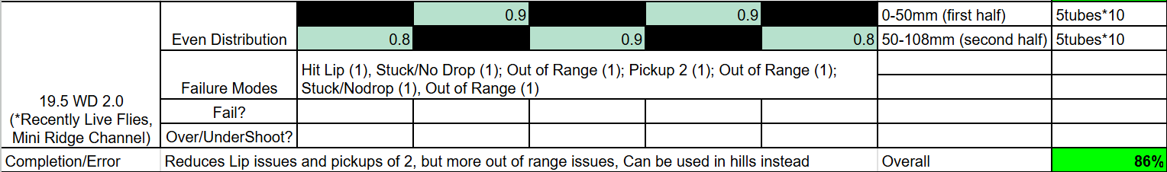
Methodology: Testing and Verifications
Notes:
Will

Slide 10
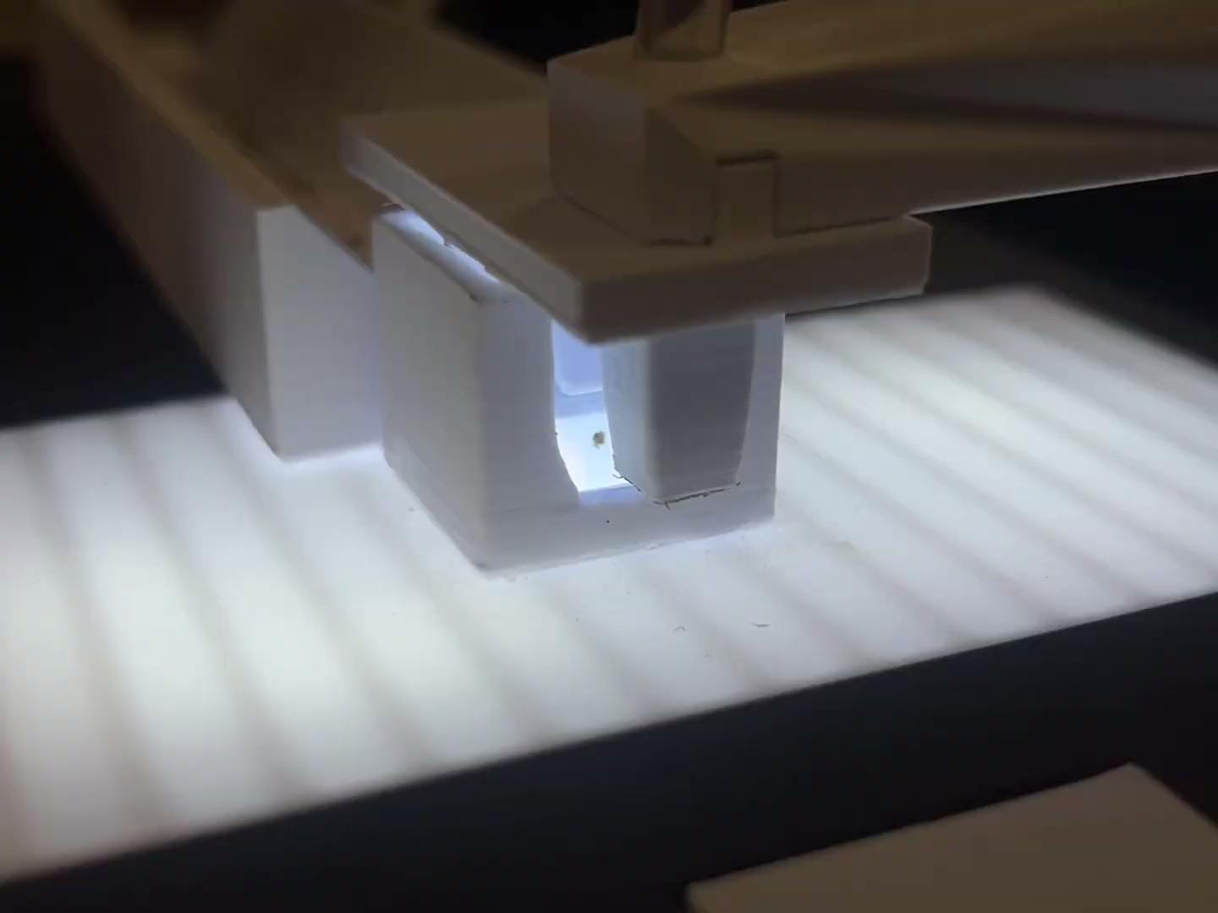
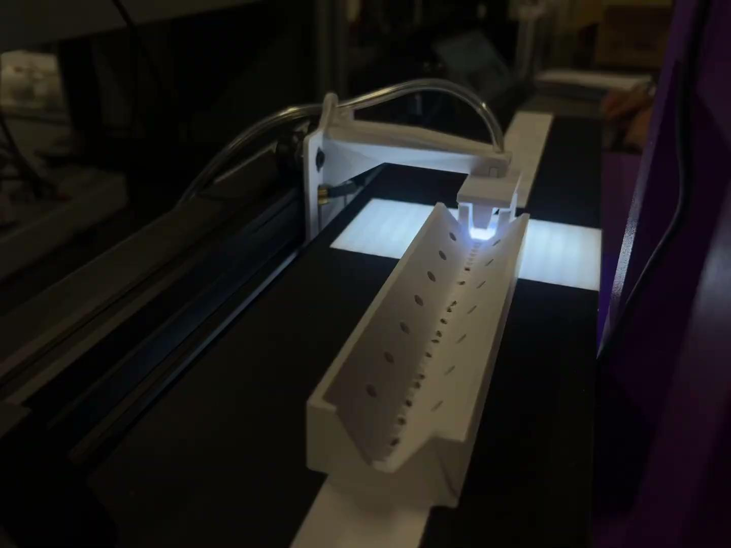
Methodology: Testing and Verifications
Notes:
Megan

Slide 11
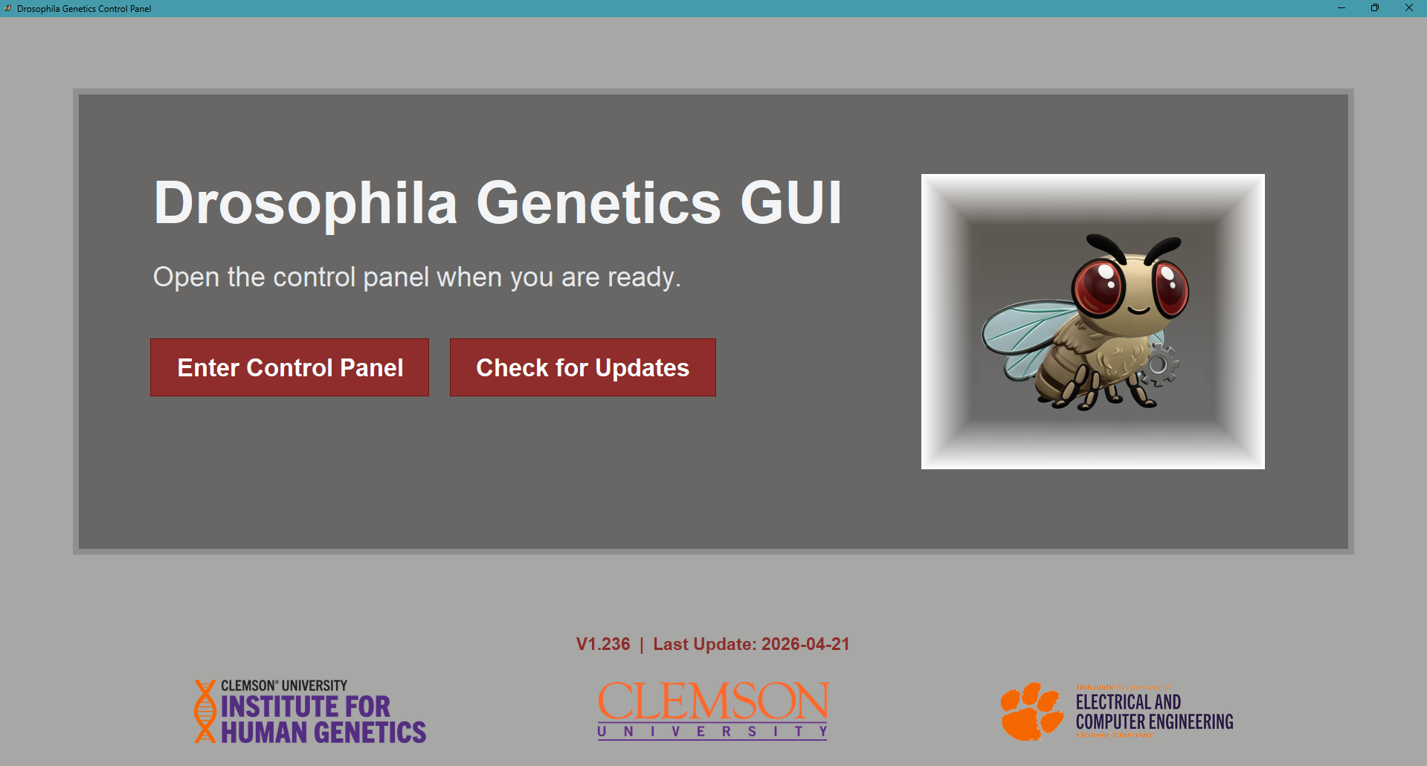
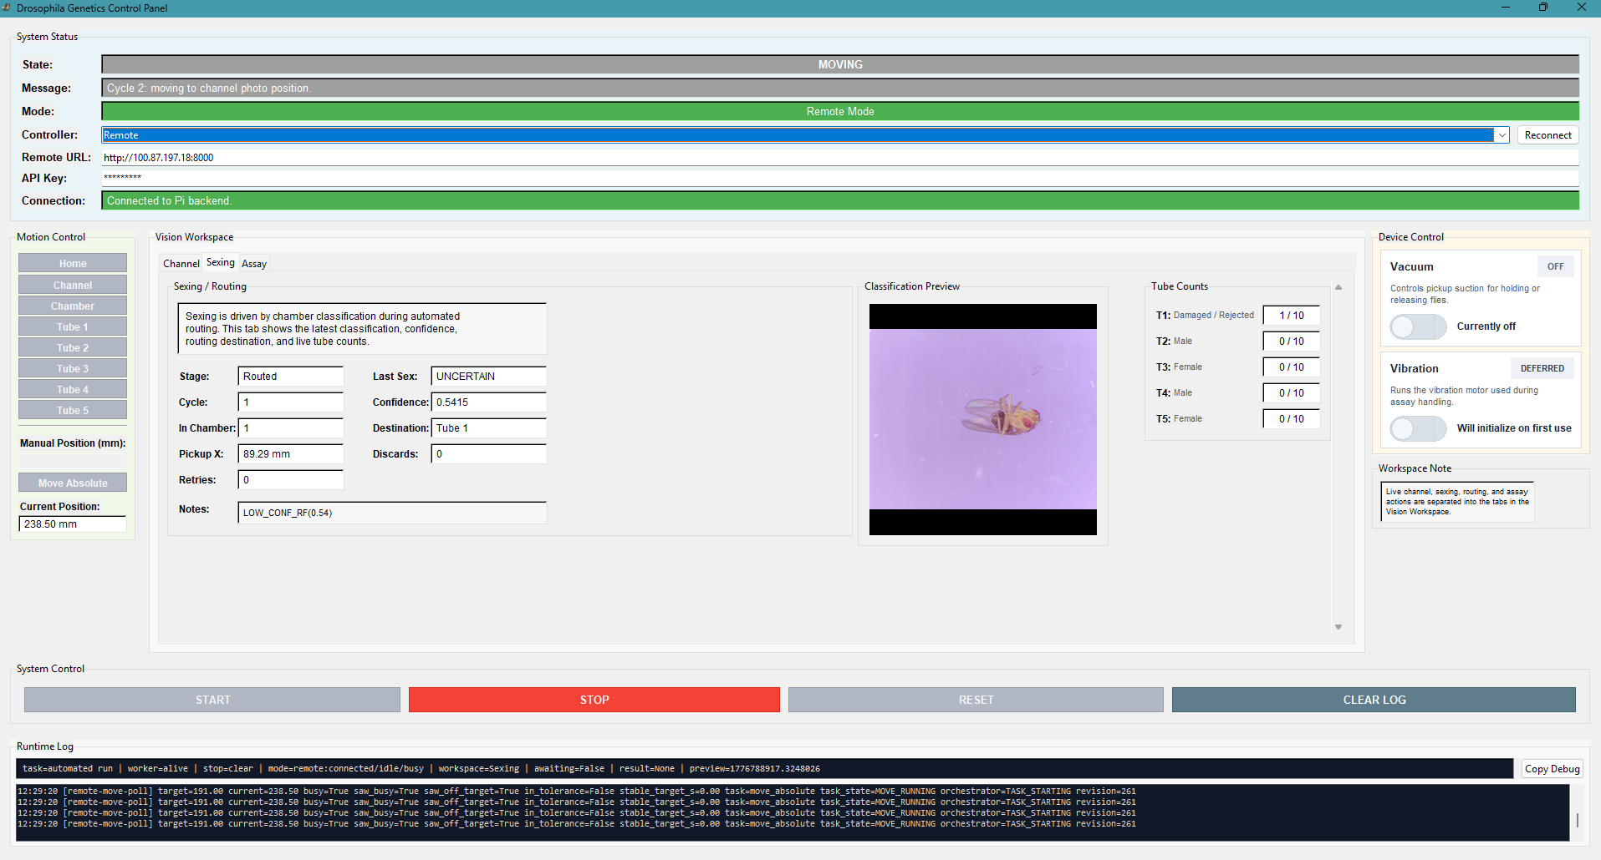
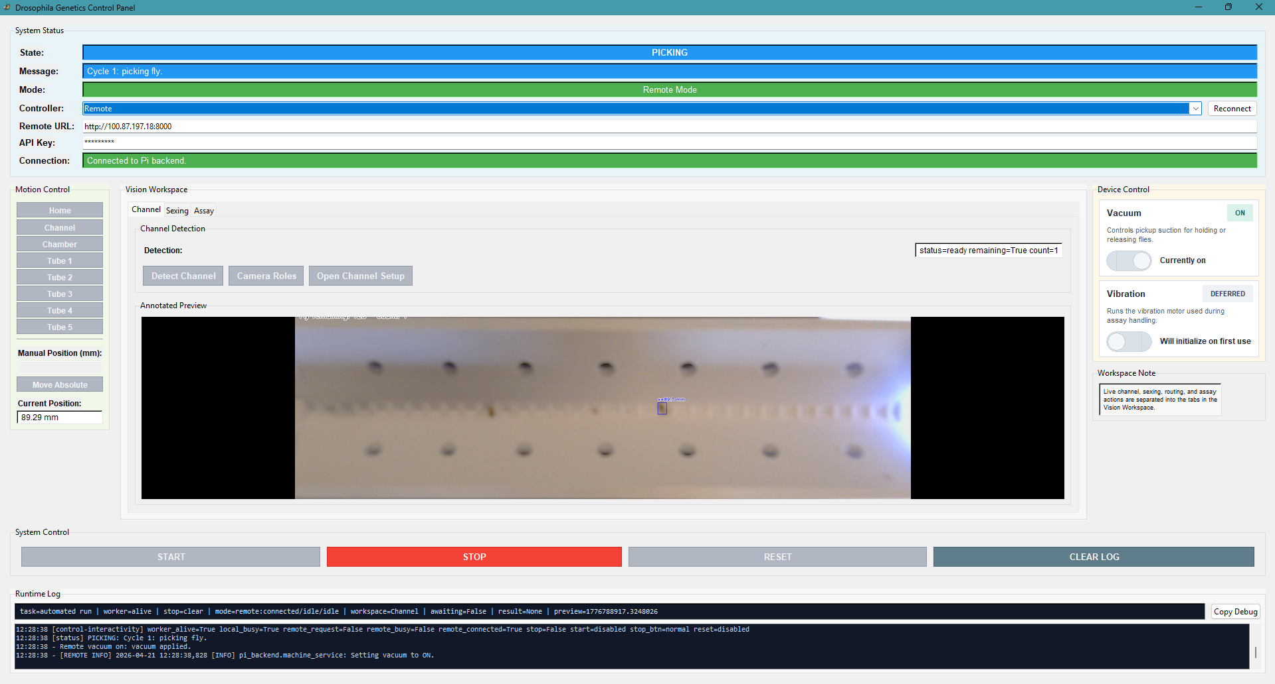
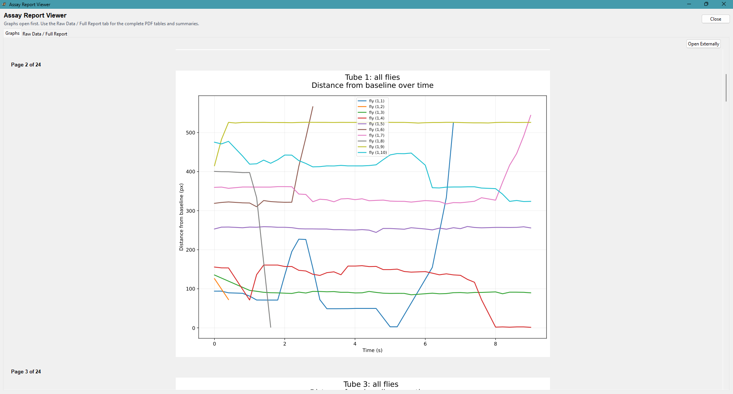
GUI
Notes:
Camren

Slide 12
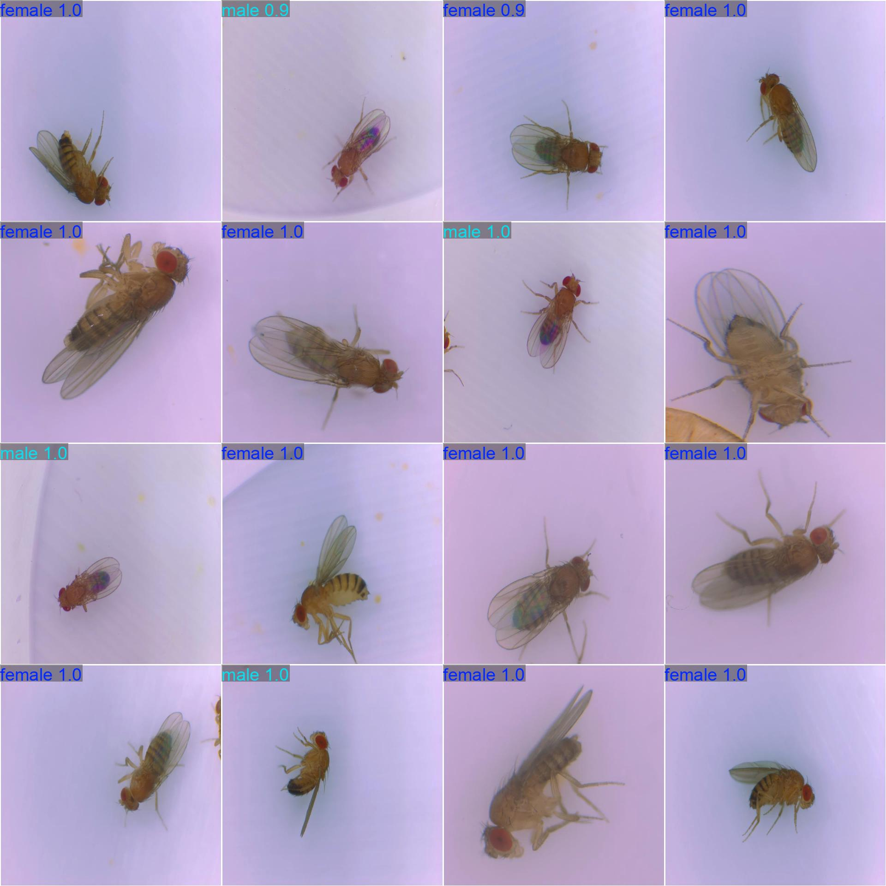
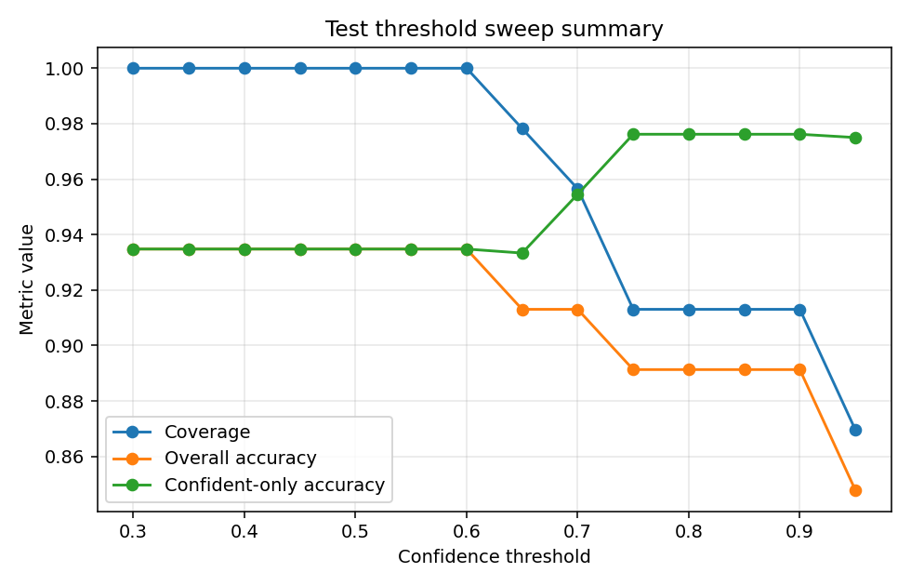
Computer Vision: YOLO Model
Example Predictions (See Green Hue)
Accuracy
Notes:
Avi

Slide 13
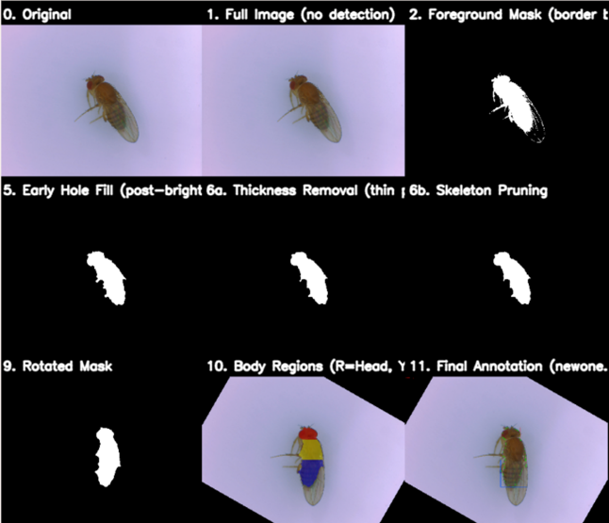
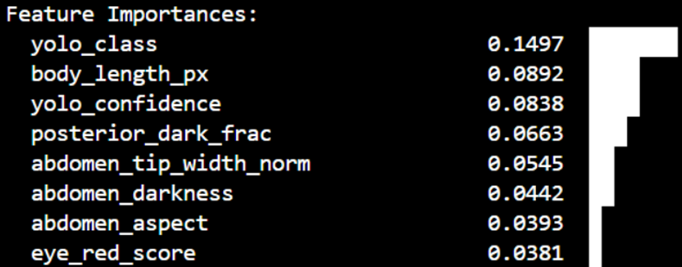
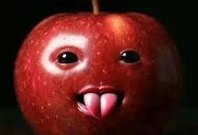
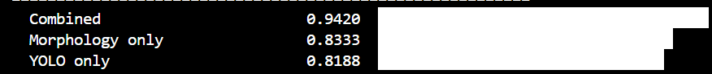
Computer Vision: Segmentation
body_length_px,body_aspect_ratio,head_len_norm,thorax_len_norm,abdomen_len_norm,thorax_abdomen_ratio,head_aspect,thorax_aspect,abdomen_aspect,abdomen_tip_width_norm,taper_rate,abd_width_peak_pos,abd_convexity,thorax_abdomen_width_ratio,centroid_pos,head_darkness,thorax_darkness,abdomen_darkness,posterior_dark_frac,striation_score,dark_band_count,abd_roughness,thorax_texture,thorax_stripe_contrast,eye_frac,eye_red_score,asymmetry,errors
28 features extracted, including 2 from YOLO. Combined is better than either.
Segmentation Process using Masking
Notes:
Dylan

Slide 14
Results
All mechanical designs have been complete
YOLO model has been trained to 95-99% accuracy
Database of over 2000 fly photos
2 flies sexed and sorted per minute
GUI with start/stop sequence, report generation and minor debugging complete and off loaded
Assay complete with report generation through GUI and uploaded to BOX
Instruction booklet complete and integrated clearly
Notes:
Camren

Slide 15
Future Directions
Updated YOLO when larger database is built
  AI Hat on Raspberry Pi
Redesign mechanical components as needed
  particularly, linear rail for larger fly quantity/capacity
Climbing Assay improvements on flies per tube, assay run time, etc, and optimize tube shapes
Better fly isolation system with potential with 2D+ gantry
PCB redesign/corrections
  Integrate motor chip and LEDs in board
  Minor orientation changes
Notes:
Dylan

Slide 16
Conclusion
This project had an immense learning curve initially, but overall has been an incredibly valuable experience. Both Electrical and Computer Engineers have learned to debug code, model parts, train ML algorithms, and most importantly work together as a team.
Thank you to Dr. Raza, ECE, and IHG for their support and contributions.
Notes:
Megan

